Slide 1
Introduction to Programming

Slide 2
What is programming?
Programming refers to a technological process for telling a computer which tasks to perform in order to solve problems. You can think of programming as a collaboration between humans and computers, in which humans create instructions for a computer to follow (code) in a language computer can understand.

Slide 3
How does computer programming work?
At its most basic, programming tells a computer what to do. First, a programmer writes code—a set of letters, numbers, and other characters. Next, a compiler converts each line of code into a language a computer can understand. Then, the computer scans the code and executes it, thereby performing a task or series of tasks. Tasks might include displaying an image on a webpage or changing the font of a section of text.

Slide 4
What is a program?
The program is a set of instructions in a certain order to solve certain task, the instruction are called statements and are written by a language that the computer can understand like C++ Python, Java, etc. …

Slide 5
What is Software Engineering?
Development
Evaluating
Testing,
Maintenance of software applications

Slide 6
What Careers Are There in Software Engineering?
Programmer
Applications Developer
Database Administrator
Mobile Developer
Program Manager
Project Leader
Quality Assurance Analyst
Software Quality Engineer

Slide 7
What 5 programming skills should all coders have?
Passion
Self-reliance
Communication Skills
Adaptability
Critical Thinking and Problem-Solving

Slide 8
How can I improve my coding skills?
Master Fundamentals
Start by learning the basics of a programming and then progressively move on to more advanced concepts. A solid foundation in programming fundamentals is critical for developing more complex coding skills.

Slide 9
Practice regularly
Write code consistently, solve coding problems, and work on personal projects. Regular practice will help you refine your coding skills, improve your problem-solving abilities, and strengthen your understanding of programming concepts.

Slide 10
Study Other’s Codes
Analyze and review code written by experienced programmers, either through code reviews, open-source projects, or online repositories. This will provide valuable insights into best practices, coding styles, and efficient problem-solving techniques.

Slide 11
Participate in Coding Challenges
Engage in online coding competitions and challenges, such as those on LeetCode, HackerRank, or CodeSignal. These challenges offer an excellent opportunity to practice, learn from others, and measure your progress.

Slide 12
Develop a growth mindset
Embrace the idea that learning and improvement are ongoing processes. Stay curious, and be open to learning new concepts, programming languages, and technologies.

Slide 13
Problem Solving Steps
Define the Problem
Generate Alternative Solutions
Implement the Solution
Select Suitable Solution
Follow up and Improve

Slide 14
Steps to Improve Problem Solving in Programming
Right Mindset
Making Right Decisions
Keeping Ideas on Track
Learning from Feedbacks
Asking Questions

Slide 15
Conclusion
Improving your problem-solving skills can be impactful both personally and professionally. By applying these fundamentals to develop your analytical and creative thinking skills, you will be able to easily and independently adapt to future personal and workplace challenges.
If your business is interested in providing professional training for your team, whether in problem solving or other business, analytics, or consulting topics, please reach out here.

Slide 16
N(N+1) (2N+1)
6

Slide 18

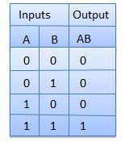

Logic Gates
AND Gate
Truth Table

Slide 19

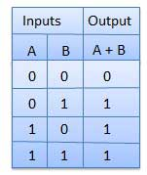

OR Gate
Truth Table

Slide 20

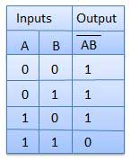
NAND Gate

Slide 21

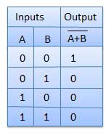
NOR Gate

Slide 22
Question 1
Draw the correct symbol and truth table for each of the following logic gates
NOT gate
b) AND gate
OR gate
NAND gate
NOR gate

Slide 23
Question 2
Write the truth table for the following logic circuit.
A
B
Q

